Slide 1
Semantic Change
Science Special Search Party (SSSP)
Ling Dai
Yilun Dai
Fangfang Wan
Jie Heng

Slide 2
Overview & Hypothesis
Project main goal: investigate what factors can influence the change of meanings of vocabularies
Hypothesis 1: Semantic change has negative correlation with relative frequency
Hypothesis 2: Semantic change has positive correlation with number of meanings (polysemy)
Notes:
Let me first introduce...
The Main goal of the project…
There are 2 hypothesis that we have tested...

Slide 3
Data Source & Data Pre-Processing
Corpus 1: The Corpus of Late Modern English Text (CLMET 3.1), well-balanced/mixed genres, relatively small corpus (202 MB), the year of some documents are not exact
Corpus 2: Gutenberg Project, large corpus (3.6 GB), fictions only (may not be very representative)
Pre-processing: word segmentation → remove common English stop words (nltk)
Notes:
We used two corpus in this project.
The first one is CLMET. Its major advantage is that it is well balanced with mixed genres, including fictions, non-fictions, dramas, etc. However it does have two disadvantage: it is a relatively small corpus with two hundred and two mega bytes; year not exact
The second Corpus is the Gutenburg Project. One of its advantages is that it is a large corpus. The other one is that years of documents are accurate. But its disadvantage is that it is a fictions-only corpus, so it may not be very representative.
For preprocessing, we conducted word segmentation, and then we removed common Eng stop words using natural language toolkit.

Slide 4
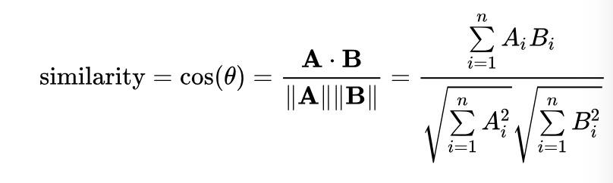
Measurement of Semantic Shift
Definition of cosine similarity: similarity between two vectors (independent of length)
(Source of equation: https://en.wikipedia.org/wiki/Cosine_similarity)
Application of cosine similarity in linguistics: cosine similarity between collocation vectors of two words → similarity of two words (meanings)
Application of cosine similarity in this project: Semantic shift - each unique word in each period has a corresponding vector, and then we calculate cosine similarity between collocation vectors of the same word, in two different periods of time
Notes:
The core concept in the measurement is…
One common application of cosine similarity in linguistics is that …
Application of cosine similarity in our project is calculating semantic shift - each unique word …….

Slide 5
Collocation
“Conditional frequency” of vocabularies: how frequently does a word pair appear together in a sentence (Mapreduce)
A reference frame: [programming, uchicago, yes, fun, bored]
Is programming fun programming: [1,0,0,0,1,0] # The first element is the count of programming
Yes programming is fun programming: [1,0,0,1,1,0]
Reducer: programming: [2,0,0,1,2,0]
Vector for programming: [0, 0, 1, 2, 0] / 2 = [0, 0, ½, 1, 0]

Slide 6
Word Count / Relative Frequency
Similar to the algorithm from class
Relative frequency = count of a unique word / total count
Analysis 1: the correlation between semantic shift and relative frequency.
Selection of reference frame for computing collocation vectors (top 1000 non-stopwords with highest relative frequencies were selected as the reference frame)
Notes:
We also used map reduce for word count and relative requency.
Algorithm is similar to that from our class
Relative frequency here is defined as the count of a unique word over the total count.
In this project, relative frequency is used in two tasks. The first task is in Analysis 1, when we calculate …
The second one is the selection of reference frame for computing collocation vectors. We picked the top 1000 non-stopwords with highest relative frequencies as the reference frame.

Slide 7
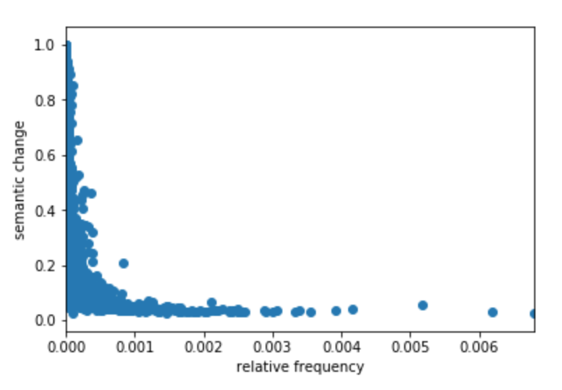
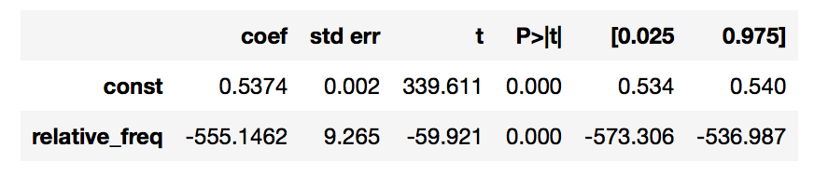
Analysis 1: Semantic Shift X Relative Frequency
Observed a negative correlation between relative frequency and semantic shift (highly non-linear)

Slide 8
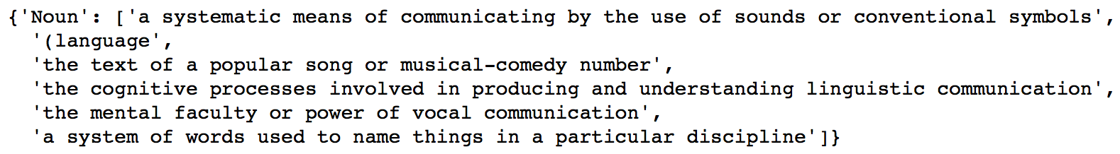
Analysis 2: Semantic Shift X Polysemy
Measurement of polysemy: PyDictionary().meaning(word)
Example: “language” → polysemy = 6

Slide 9
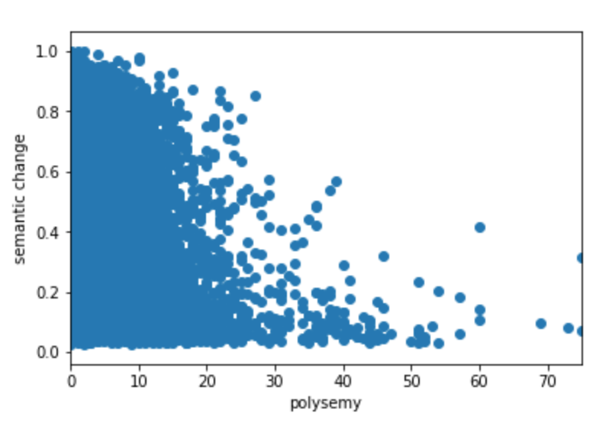
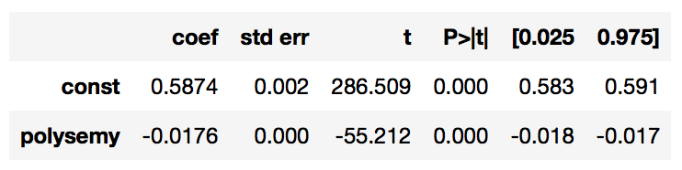
Analysis 2: Semantic Shift X Polysemy

Slide 10
Further Analysis: Semantic Shift X Period
Average magnitude of semantic change as a time series
Period 1: 1710-1780 → Period 2: 1780-1850 → Period 3: 1850-1920
Average Semantic Change: 0.5202187253842431
Average Semantic Change: 0.5059622093006751

Slide 11
References:
https://en.wikipedia.org/wiki/Cosine_similarity

